Slide 1
Google VR Head Gestures
With Black Jack

Slide 2
Gesture Based Game Using Google VR
Original Idea
3D Game in unity
Controlling Game object with Mobile Gyroscope/Accelerometer
With Game objects to avoid and collect
Hand or head gestures were planned to be used
Problems with the Idea
Phone data not streaming correctly
A known problem with my device.

Slide 3
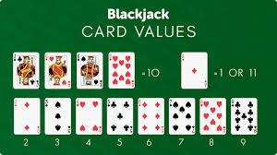
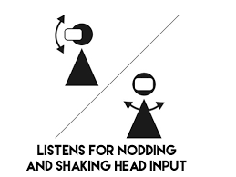
New Plan
Idea for a black jack game.
Using head gestures to control the user input.
Nodding Yes/No to stick or twist
Justification for Yes and No Head gestures
Universally Understood form of communication
Short instruction set needed
Quickly becomes obvious on how to use
Other options
Tilt head Left/Right
Look Left/Right
Look Up/Down
Use Gaze Input (Not working with latest Unity)
Reason for choosing Black Jack
The rules of stick or twist map perfectly to yes no head gestures
Had considered a Higher or lower card game
Black Jack is more widely known

Slide 4
Black Jack
Game Development.
YouTube Series
Fishers shuffle for deck of cards
Random number between 0 – 51
Number selected place on stack
Remove selected number from
Random number between 0 – 50
Repeat until list is empty
A pdf of card deck used and split in sprite editor.
Values added to cards based on mod 13 of sprites ordering
Three elements (Each one an array)
Player (on turn push from the deck array)
The deck (pop from the deck array at every turn and start game)
The dealer (on turn push from the deck array)
Buttons in UI for testing (Event Handlers to map to functions)
Twist
Stick
Play again

Slide 5
Google VR
Unity development package
Link here …
Head gesture input
Git hub link to Head Gesture page .
Tying this into the game environment
Triggering functions

Slide 6
Problems while developing
Unity view incorrect when running
Game view is not stereoscopic as it used to be
Need phone build every time to debug
Frame rate problems (Varying degrees of nod)
Amount of head movement needed to recognise gesture
Resetting the gesture to zero
Small bugs just configuration issues

Slide 7
Deploying to Google Store
Steps needed
Build apk for testing
Follow best practice check list
Deploy for testing
Wait for results……………………….
Is it live now?

Slide 8
Demo of the game
YouTube Demo

Slide 9
Conclusion
What do I still need to do to complete the project?
Bugs
Centre position of game objects in phone view
Reset Head position
Pros
The process of VR app creation with Google VR.
Lots of resources
Many people had the same problems I had (with easy fixes)Cons
Cons
Lots of setup with Android apk and Google VR with unity
Latest update has little to no backwards compatibility
Limited in app unity view
Unity view is not the same as phone build view

